Slide 1

Topic 8: Functionals and Modelling with purrr

Slide 2
Course Overview
Topic | Description
Session 1
1 | Introduction to R and R Studio Cloud
2 | Exploratory Data Analysis: the tibble and ggplot2
3 | Functions, Vectors and Lists
4 | Introduction to Functionals with purrr
5 | Data Transformation I with dplyr
Session 2
6 | Data Transformation II with dplyr
7 | Statistical Transformation with ggplot2
8 | Functionals and Modelling with purrr
9 | Exploratory Data Analysis - Case Study using aimsir17

Slide 3

Introduction to purrr
http://www.rebeccabarter.com/blog/2019-08-19_purrr/
purrr is all about iteration.
purrr introduces map functions (the tidyverse’s answer to base R’s apply functions, but more in line with functional programming practices) as well as some new functions for manipulating lists

Slide 4
Introduction to purrr
http://www.rebeccabarter.com/blog/2019-08-19_purrr/
While the workhorse of dplyr is the data frame, the workhorse of purrr is the list.
A vector is a way of storing many individual elements (a single number or a single character or string) of the same type together in a single object,
A data frame is a way of storing many vectors of the same length but possibly of different types together in a single object
A list is a way of storing many objects of any type (e.g. data frames, plots, vectors) together in a single object

Slide 5
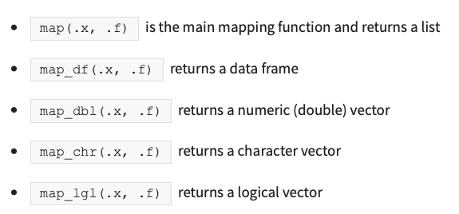
(1) Map functions
A map function is one that applies the same action/function to every element of an object (e.g. each entry of a list or a vector, or each of the columns of a data frame)
The naming convention of the map functions are such that the type of the output is specified by the term that follows the underscore in the function name
Consistent with the way of the tidyverse, the first argument of each mapping function is always the data object that you want to map over, and the second argument is always the function that you want to iteratively apply to each element of the input object

Slide 6
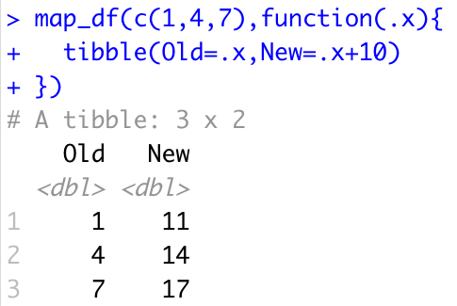
map_df()
If you want to return a data frame, then you would use the map_df() function.
However, you need to make sure that in each iteration you’re returning a data frame which has consistent column names.
map_df will automatically bind the rows of each iteration.

Slide 7
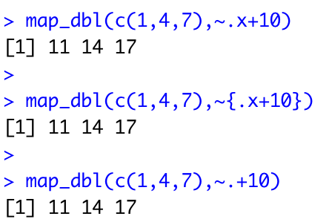
(2) The tilde-dot shorthand for functions
To make the code more concise you can use the tilde-dot shorthand for anonymous functions (the functions that you create as arguments of other functions).
~ indicates that you have started an anonymous function, and the argument of the anonymous function can be referred to using .x (or simply .).
Unlike normal function arguments that can be anything that you like, the tilde-dot function argument is always .x.

Slide 8
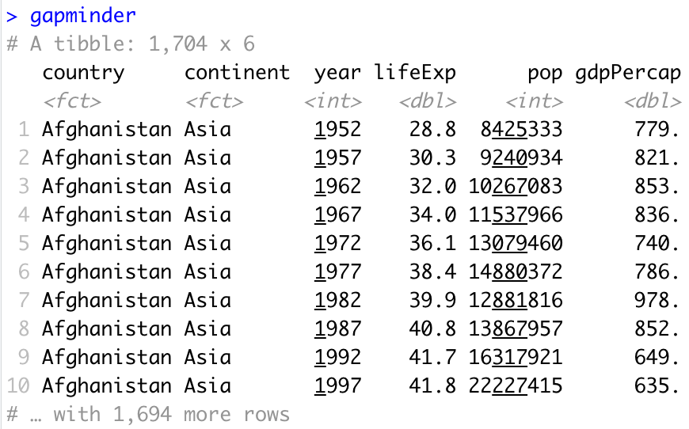
gapminder package
The gapminder dataset has 1704 rows containing information on population, life expectancy and GDP per capita by year and country.
It’s in tidy data format
http://www.rebeccabarter.com/blog/2019-08-19_purrr/

Slide 9
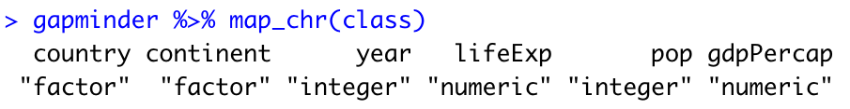
Analysing gapminder
Since gapminder is a data frame, the map_ functions will iterate over each column.
An example of simple usage of the map_ functions is to summarize each column.
For instance, you can identify the type of each column by applying the class() function to each column.
Since the output of the class() function is a character, we will use the map_chr() function:

Slide 10
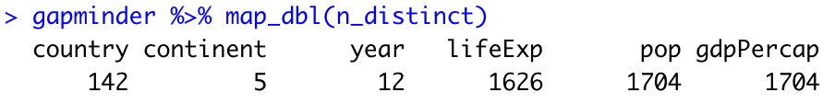
Further analysis
http://www.rebeccabarter.com/blog/2019-08-19_purrr/
Similarly, if you wanted to identify the number of distinct values in each column, you could apply the n_distinct() function from the dplyr package to each column.
Since the output of n_distinct() is a numeric (a double), you might want to use the map_dbl() function so that the results of each iteration (the application of n_distinct() to each column) are concatenated into a numeric vector:

Slide 11
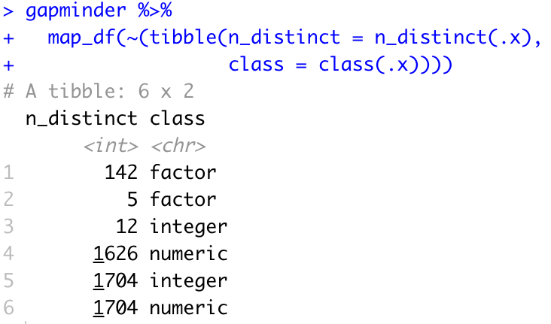
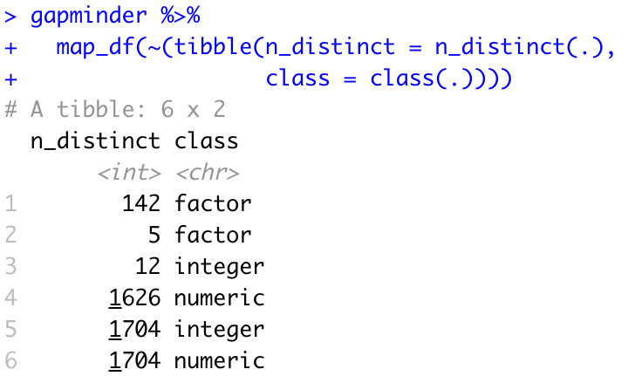
If you want to do something a little more complicated, such return a few different summaries of each column in a data frame, you can use map_df().
You typically need to define an anonymous function that you want to apply to each column.
Using the tilde-dot notation, the anonymous function calculates the number of distinct entries and the type of the current column (which is accessible as .x), and then combines them into a two-column data frame.
Once it has iterated through each of the columns, the map_df function combines the data frames row-wise into a single data frame.

Slide 12
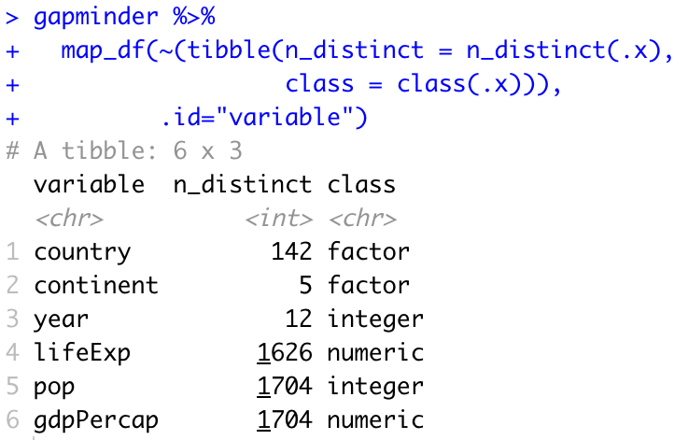
Adding the variable name
http://www.rebeccabarter.com/blog/2019-08-19_purrr/
The variable names correspond to the names of the objects over which we are iterating (in this case, the column names), and these are not automatically included as a column in the output data frame.
You can tell map_df() to include them using the .id argument of map_df().
This will automatically take the name of the element being iterated over and include it in the column corresponding to whatever you set .id to

Slide 13
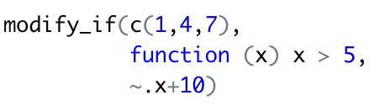
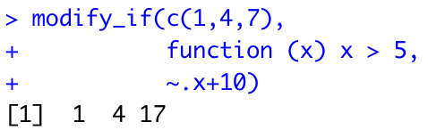
modify_if()
modify_if(), only applies the function to elements that satisfy a specific criteria (specified by a “predicate function”, the second argument called .p).
For instance, the following example only modifies the third entry since it is greater than 5.

Slide 14
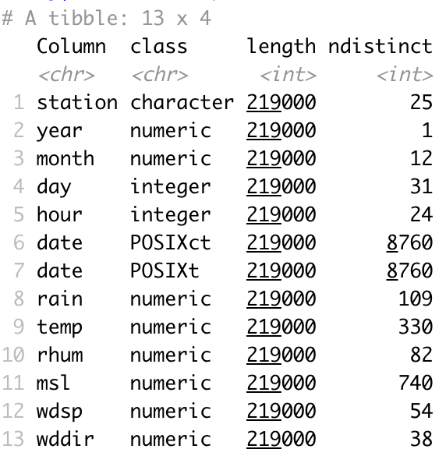
Challenge 8.1
Generate the following tibble from aimsir17::observations, making use of map_df()

Slide 15
(3) Statistical Analysis - mpg

Slide 16
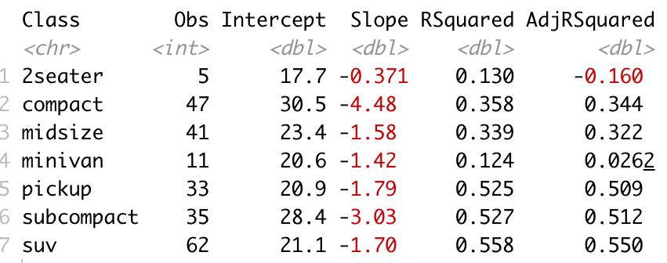
Getting to the details…

Slide 17
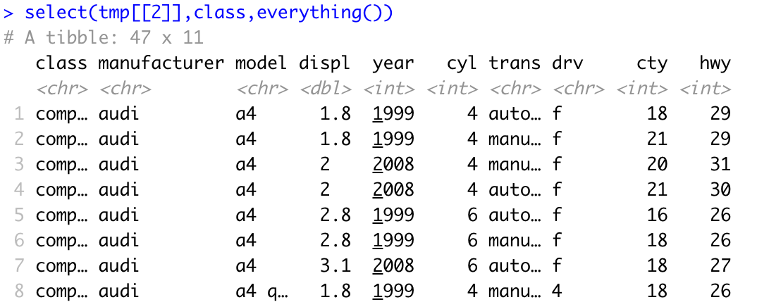
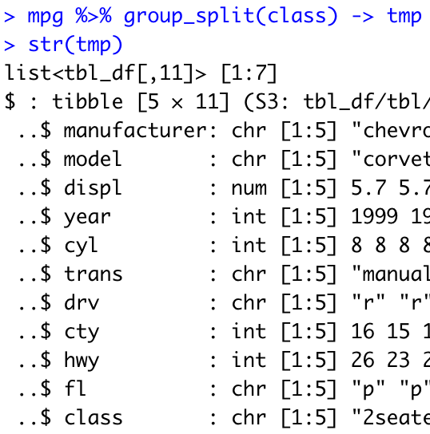
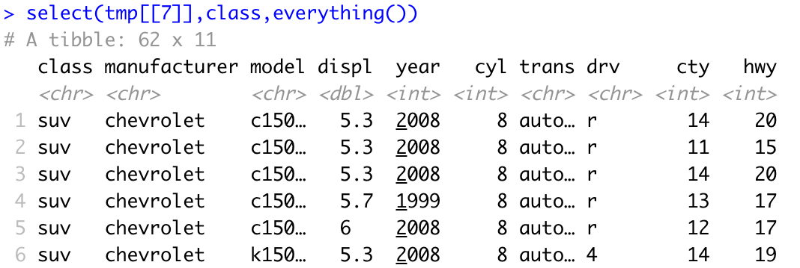
dplyr and purrr

Slide 18
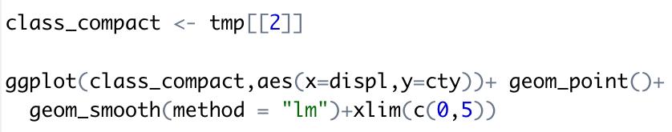
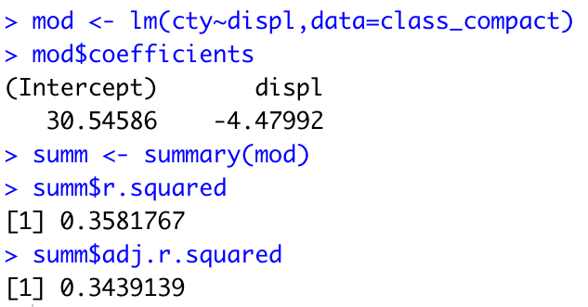
A linear model, with some model results

Slide 19
Overall Approach
Group the data by class
For each class, calculate and record:
Number of observations
Class name
Intercept
Slope
RSquared
AdjRSquared
Return as a tibble

Slide 20
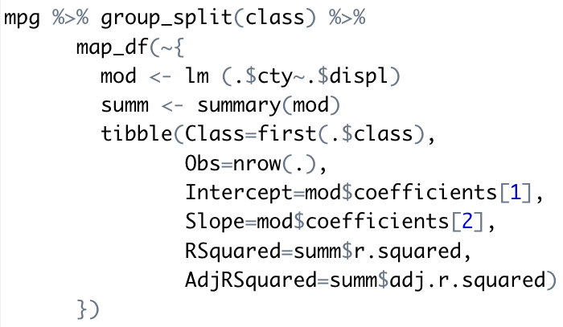
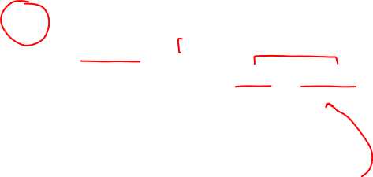
R Script

Slide 21
Challenge 8.2
Generate a similar tibble for the manufacturers in mpg.
For this example, use hwy as the dependent variable, and cyl as the independent variable
Check the results using ggplot() and geom_smooth()

Slide 22
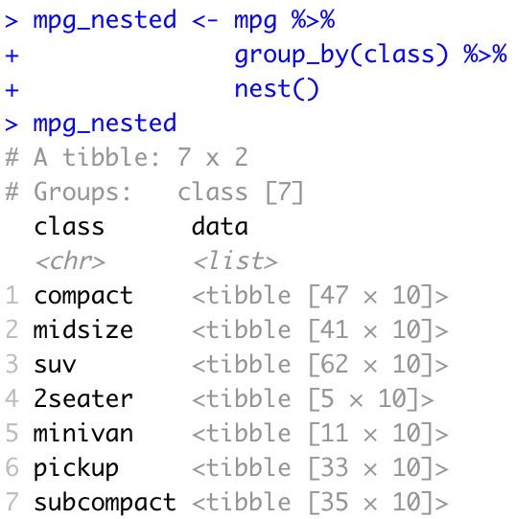

(4) Nesting of Tibbles
Tibble columns can be lists (as opposed to vectors, which is what they usually are)..
For instance, a tibble can be “nested” where the tibble is essentially split into separate data frames based on a grouping variable, and these separate data frames are stored as entries of a list (that is then stored in the data column of the data frame).

Slide 23
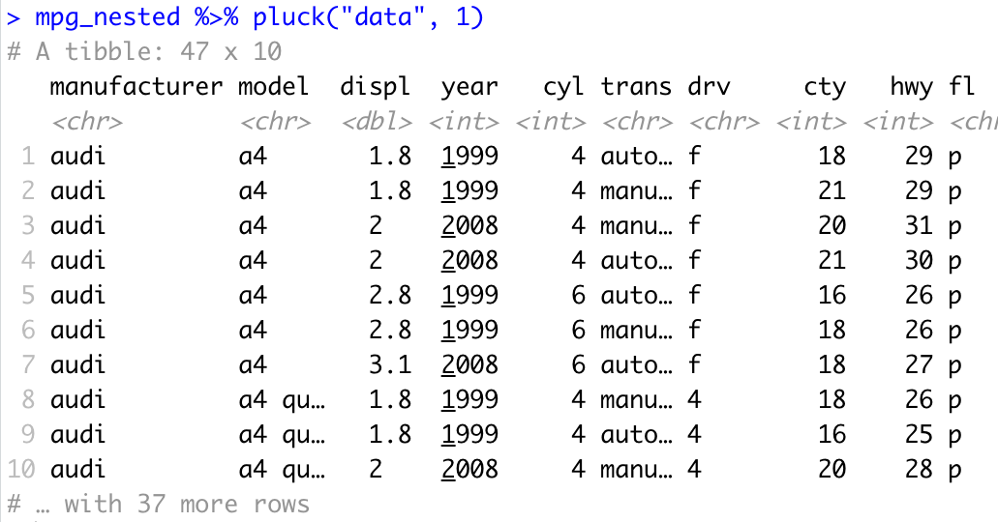
Extracting data (pluck function)

Slide 24
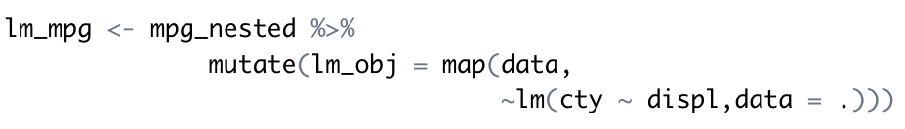
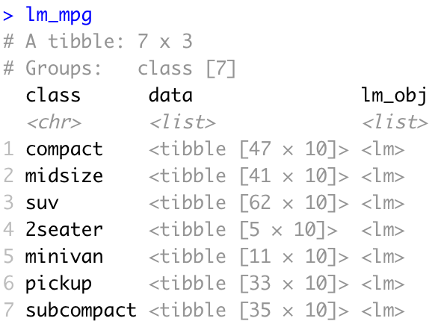
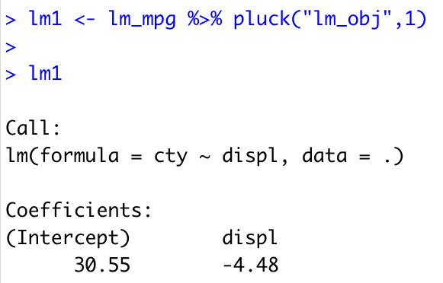

Storing model results as a column

Slide 25
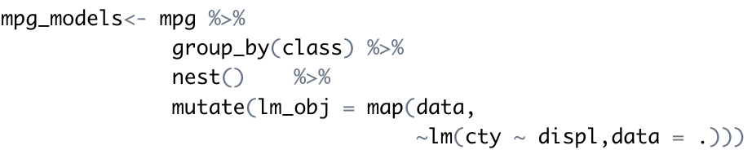
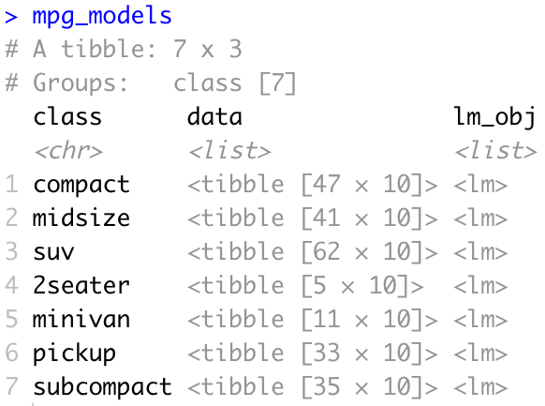
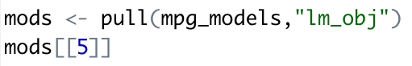
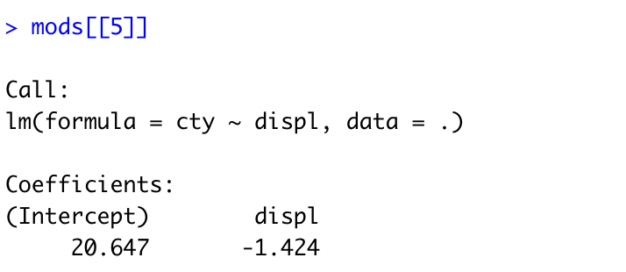

Slide 26
Challenge 8.3
Generate a similar set of models (25) for observations (by station), where wdsp is the dependent variable, and msl is the independent variable

Slide 27
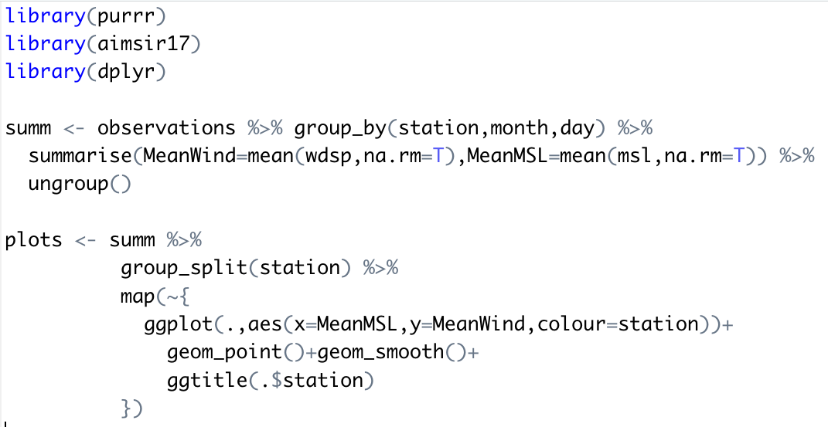
(5) Generating Multiple Plots

Slide 28
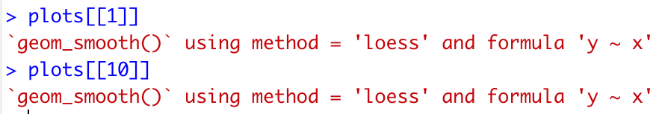

Slide 29

Summary
map functions
~ anonymous function
Statistical analysis
nest() function
Generating multiple plots

Slide 30
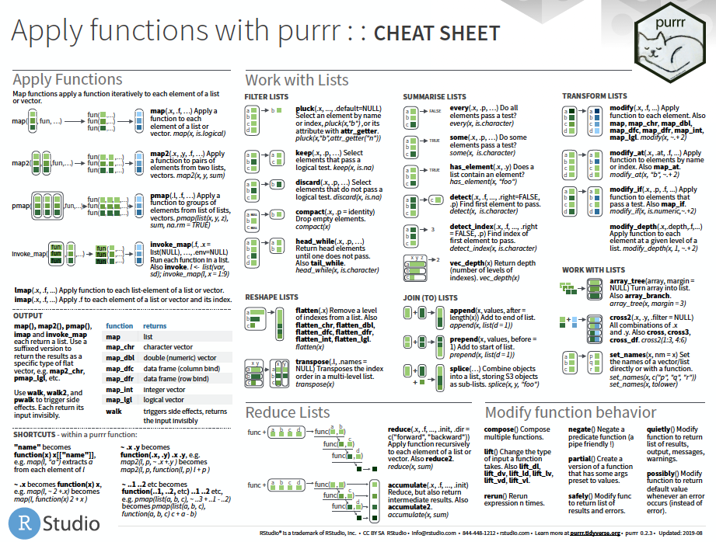

Slide 31
